Slide 1
CIDM 6312- Seminar in Information Visualization.
Homework 2
Submitted by: Tiwalope Shadare

Slide 2
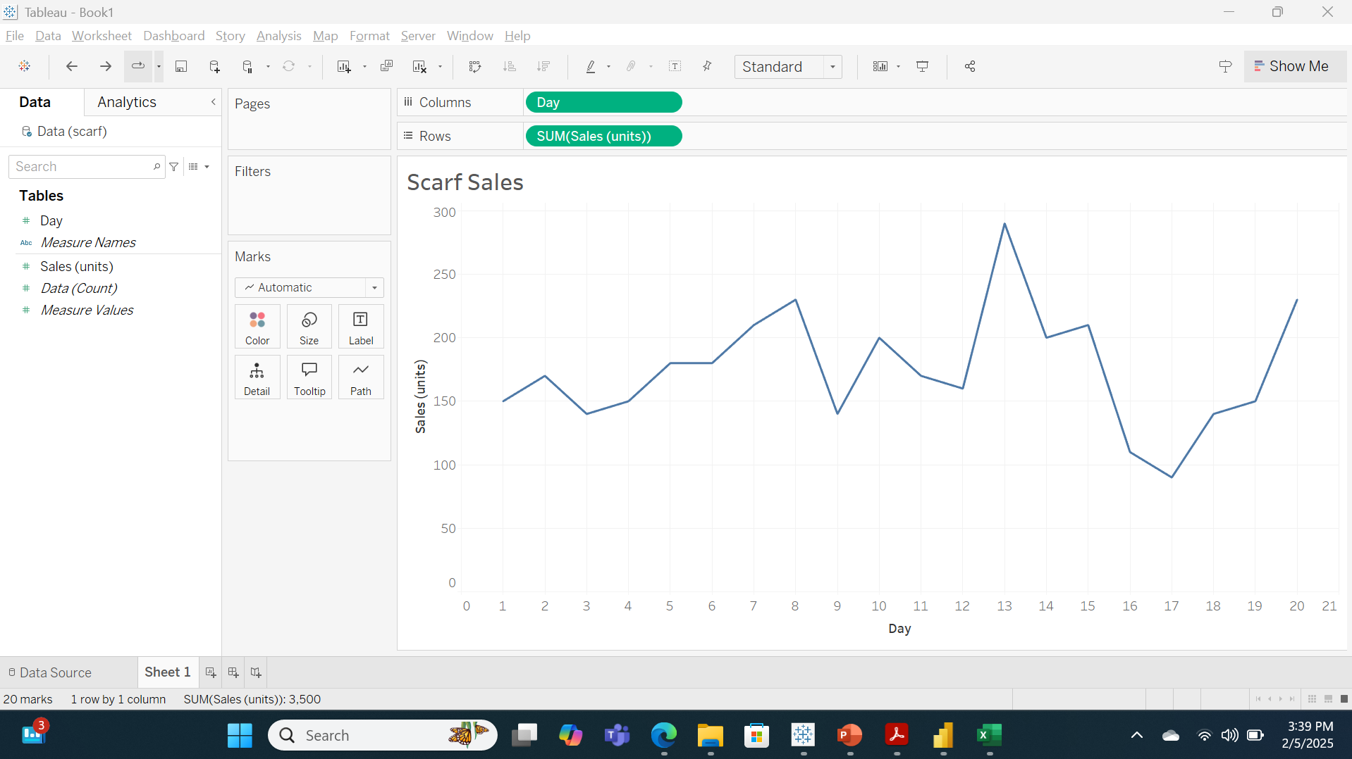
Part 1 - Initial Line Chart for Scarf Sales by TS.

Slide 3
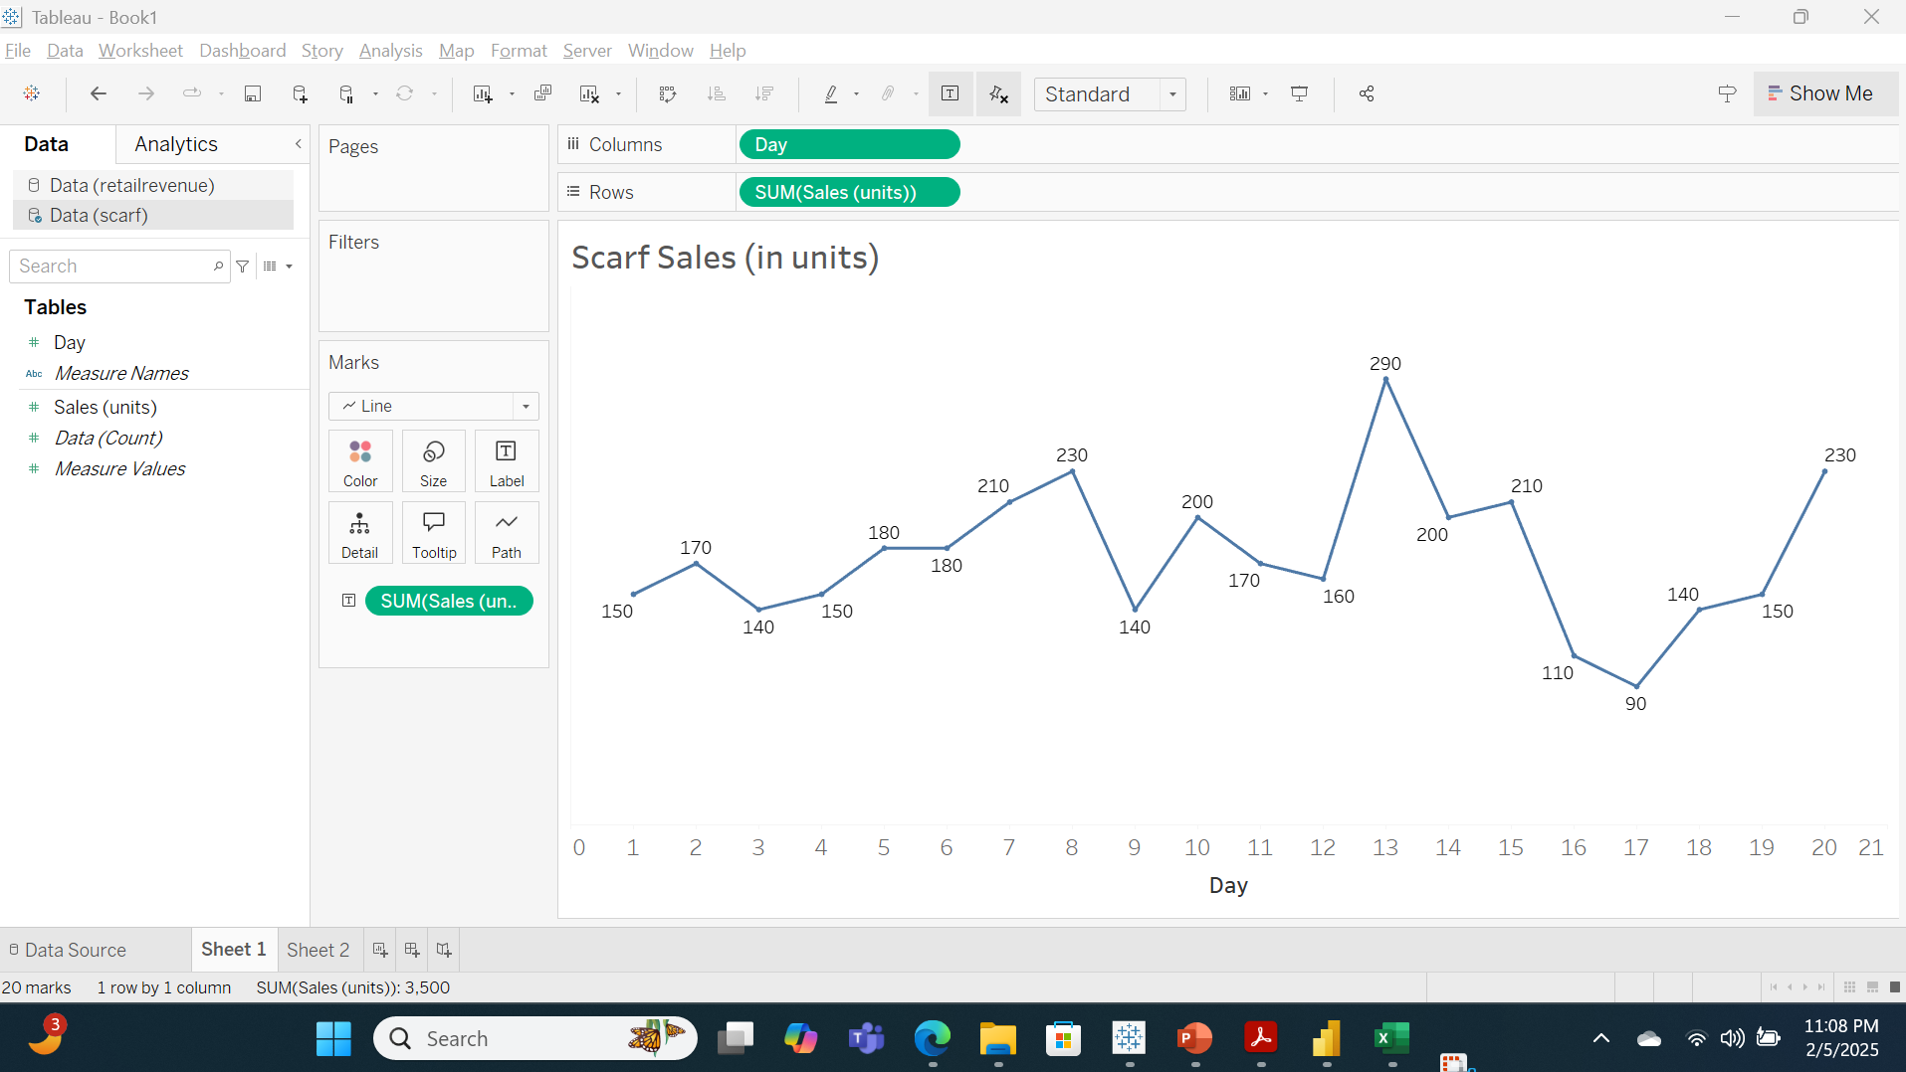
Part 1 -Revised Line Chart for Scarf Sales by TS

Slide 4
Why the Changes were necessary based on Chapter 3 concepts
The following changes were made to the revised chart:
1. Decluttering: The gridlines were removed to increase the ‘Data-Ink Ratio’. The gridlines were unnecessary to convey the required meaning of the data to the audience, therefore, it was a non-data-ink and had to be removed. The vertical axis was also removed for the same reason.
2. Minimizing Eye-Travel: The data labels for the units of scarf sold was added to the line graph to minimize the eye travel of the audience and reduce the cognitive load needed to know how many scarfs were sold in a particular day. Without the data labels, the audience would have had to trace the number from the vertical axis which will maximize eye travel and increasing the cognitive load.
3. Connection: With this line chart being a time series data, the Gestalt principle of connection was used to show the scarf sales across a 20-day period. This helped in giving the audience snapshot how the sales for the period covered. We can see that sales peaked on day 13 with 290 units sold.

Slide 5
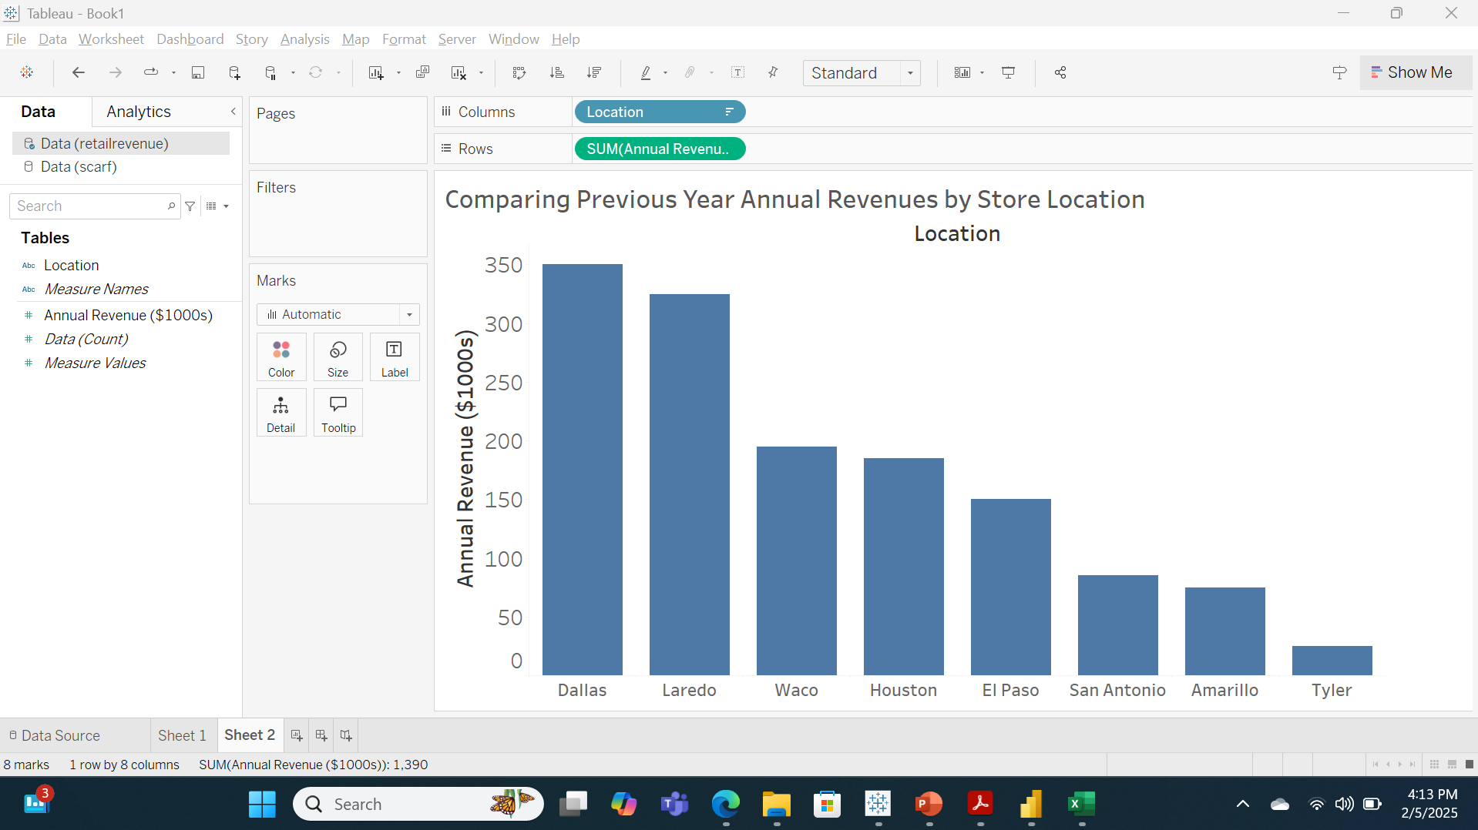
Part 1 - Sorted Column Chart for Annual Revenues by TS.

Slide 6
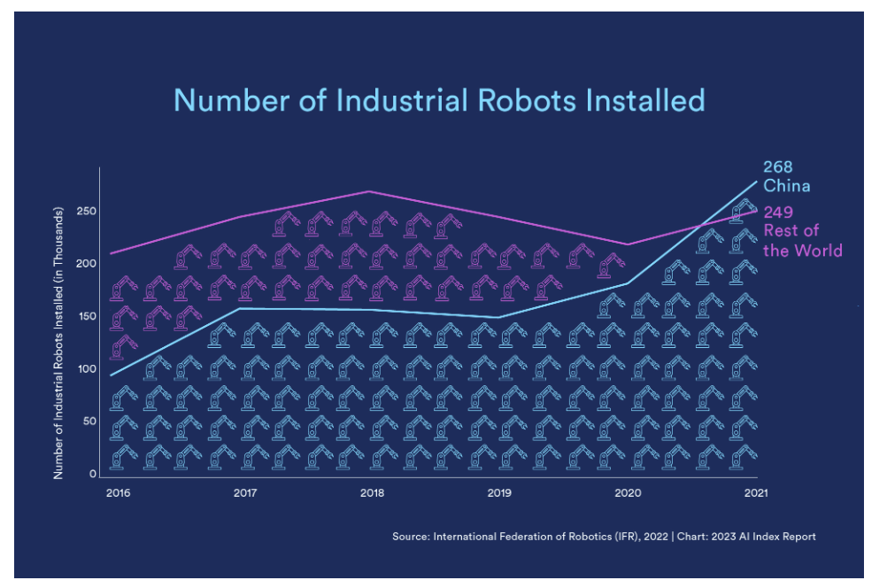
Part 2 - Chart of Number of Industrial Robots installed

Slide 7
Goal, Chart type, and Hyperlink (Slide 6)
Goal: The goal of this chart is to show the audience the number of industrial robots installed in China vs the rest of the world between 2016 and 2021.
Chart Type: Line chart (this can also be considered as an area chart due to the images included in the chart).
Hyperlink: 2023 State of AI in 14 Charts

Slide 8
Analysis & Critique/Proposed Corrections
Analysis & Critique
Preattentive Attributes used in the chart: Color
Gestalt Principles: Similarity, connection
Data-Ink Ratio: Low Data-Ink Ratio as there were images in the chart that were not needed to convey the necessary details
•Other Data Visualization Design Issues:
  The blue and purple robotic images included in the chart were unnecessary. It makes the chart look cumbersome and cluttered, decreasing the data-ink ratio
  The horizontal axis lacked its label.
  The data label was only added to the end of the line and not specified for each year. Trying to figure out the values for the years in the middle will involve tracing the line which will maximize eye travel and increase cognitive load.
Proposed Corrections
Change the chart type from the current chart type to a simple dual-line chart. The robotic images should be removed.
Change the background color from blue to white to provide more contrast.
Add data label not only to the end of the line (the year 2021) but for each year in our analysis. This will minimize eye travel and reduce cognitive load.
Add horizontal axis label “year”.

Slide 9
Revised chart for Number of Industrial Robots by TS

Slide 10
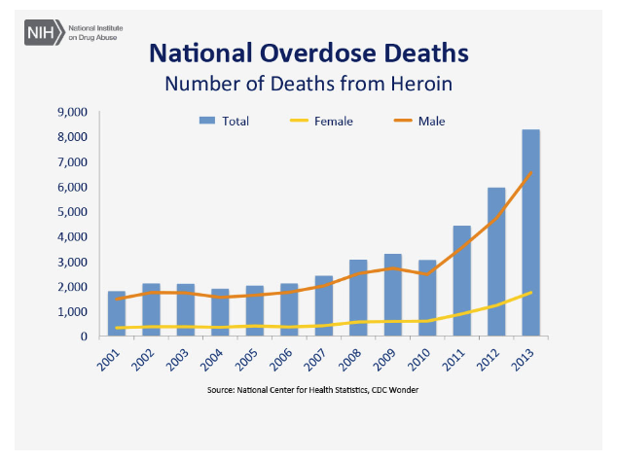
Part 2 - Chart of Number of Deaths from Heroin (2001 – 2013)

Slide 11
Goal, Chart type, and Hyperlink (Slide 10)
Goal: The Chart depicts the total number of overdose deaths from heroin in the United States from 2001 to 2013. It also shows the number of female and male overdose deaths, specifically from heroin.
Chart Type: Column chart (to depict the total) and Line chart (to depict the male and female numbers).
Hyperlink: Drug Use and Heroin Addiction: Informative Speech | Free Essay Example

Slide 12
Analysis & Critique/Proposed Corrections
Analysis & Critique
Preattentive Attributes: color, length
Gestalt Principles used in the chart: similarity
Data-Ink Ratio: Moderately low data-ink ratio, there are no unnecessary gridlines, but the double heading is quite an overkill.
Other Data Visualization Design Issues:
  The choice of the chart is not right for the message being depicted in the chart. Stacked column charts do a better job of portraying composition.
  There are no axes labels. I understand that the graph can be easily understood, however, axes labels would have been helpful.
  This chart maximizes eye travel and cognitive load. If an end user wants to know how many males died in a certain year, they will have to figure out which line color to look out for and then trace the line to the vertical axis.
Proposed Corrections
  Changing the chart to a stacked column chart would have been a better choice in conveying the message.
  Add axes labels to the vertical and horizontal axes.
  Add Data labels to minimize eye travel and cognitive load.

Slide 13
Revised chart for Number of Deaths from Heroin by TS

Slide 14
Part 3 - Reflection
Summary of Key Learning
Some of the visualization principles and concepts discussed in the third chapter include:
Preattentive Attributes: Attributes such as color, form, length, spatial positioning, and movements are important attributes to consider when creating a data visualization tool. These are attributes that can be processed quickly, which is the essence of a good visualization tool. The charts in my examples made use primarily of the color attribute and the length attribute in the second chart.
Gestalt Principles: Principles such as connection, similarity, enclosure, and proximity are important to the creation of effective data visualization. The time series data in my examples made use of the connection principles, which is typical of time series data.
Decluttering: The concept of eliminating unnecessary ink in a chart and ensuring a high data-ink ratio. Increasing the data-ink was the bedrock of my examples as decluttering was needed to achieve better charts.
Minimizing Eye Travel: The notion of minimizing cognitive load by minimizing eye travel in charts, can be achieved by keeping all necessary data needed to interpret a chart close by.
Choosing The Right Font: Selecting the correct font for my chart has never been something I considered before taking this class, So I was grateful to find out that there are dos and don’ts of font types to use.
Wrong types of chart: I learned that certain chart types such as Pie Charts and Area Charts are discouraged. The wrong type of chart was used in my second example, which played a role in the readability of the chart.

Slide 15
Part 3 - Reflection
Application of Concepts
Some of the concepts I will practice in my work as a business analyst include:
Ensuring that only the necessary information will go on my chart. Going forward, I will make sure that my visualization tools for my ad-hoc charts and reports needed at work are decluttered and only have the necessary information needed to convey my data and maintain a high data-ink ratio.
Choosing the right chart and the right font will be something I’ll keep in mind now. Before this class, the Pie chart has always been my go-to chart to visualize quantitative data that adds up to 100 (percentages). Thanks to this class, I now know that bar and column charts are a better alternative. Also, choosing sans-serif fonts for my visualization chart and avoiding serif fonts will be added to my arsenal of knowledge.

